Slide 1
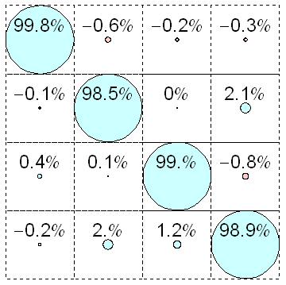
a)
b)
e) raw
10
01
00
11
f) readout error
corrected
c)
|1>
|0>
|1>
|0>
1
81%
81%
0
93%
88%
d)
|00>
|01>
|10>
|11>
I10>
g) readout crosstalk
corrected
00
01
I01>
10
I00>
11
I11>

Slide 2
a) raw
d)
10
01
00
11
b) readout error
corrected
e)
|1>
|0>
|1>
|0>
81%
81%
1
93%
88%
0
I10>
c) readout crosstalk
corrected
f)
|00>
|01>
|10>
|11>
00
I01>
01
10
I00>
11
I11>

Slide 3
Original file at: L:\local-expdata\FO-C5\3rd-Run\2011_04_22\s curves.opj

Slide 4
Original file at: L:\local-expdata\CT1-4thRun\100402\auto spectro\qubit spectroscopies.opj

